Slide 1

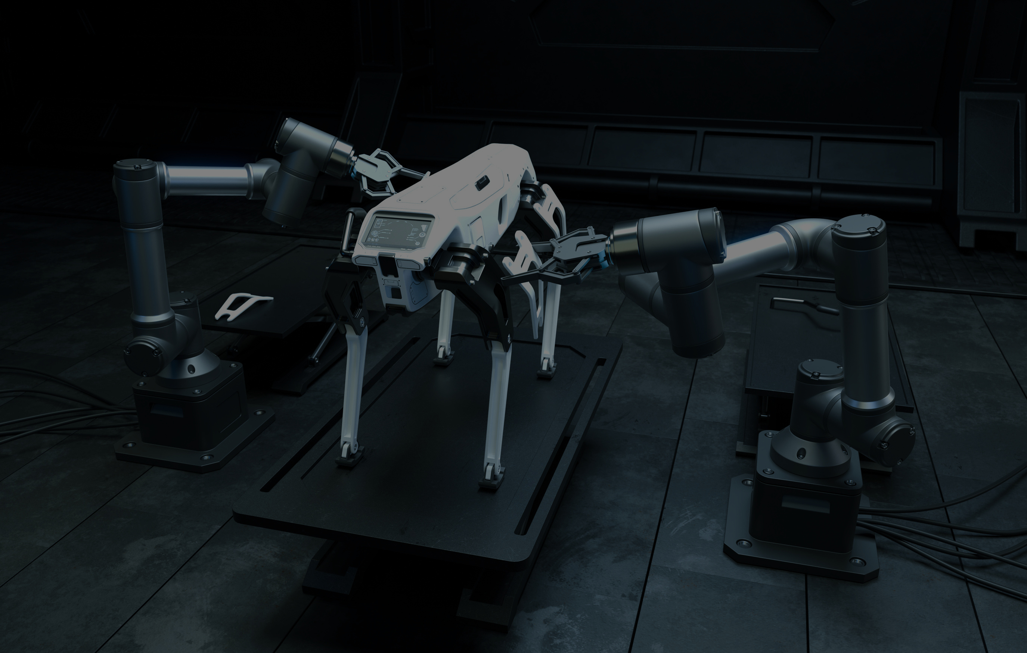



PREDICTING 30-DAY HOSPITAL READMISSIONS
USING AI AND MACHINE LEARNING
Turning clinical data into responsible, explainable decision support
Author: John Raffy Raymundo
Program: AI and ML Capstone (Technical Presentation)
Year: 2025
Github link: Predicting 30-Day Hospital Readmissions Using Machine Learning
next

Slide 2


02
PROJECT OVERVIEW
The Challenge: Avoidable readmissions
The question: Can we identify risk before discharge?
The task: Binary Classification using real-world clinical data
The approach: End-to-end, ethical ML pipeline
The outcome: Interpretable risk insights for clinicians
next
Notes:
Before diving into the technical details, I’ll start with a brief overview of the project.
The problem addressed is the prediction of 30-day hospital readmissions, which is framed as a supervised binary classification task.
The analysis uses a large, multi-hospital clinical dataset and follows a complete machine learning lifecycle, from preprocessing to modeling, explainability, and fairness assessment.
The final output is an interpretable risk prediction generated at discharge, designed to be usable in real-world clinical settings.

Slide 3

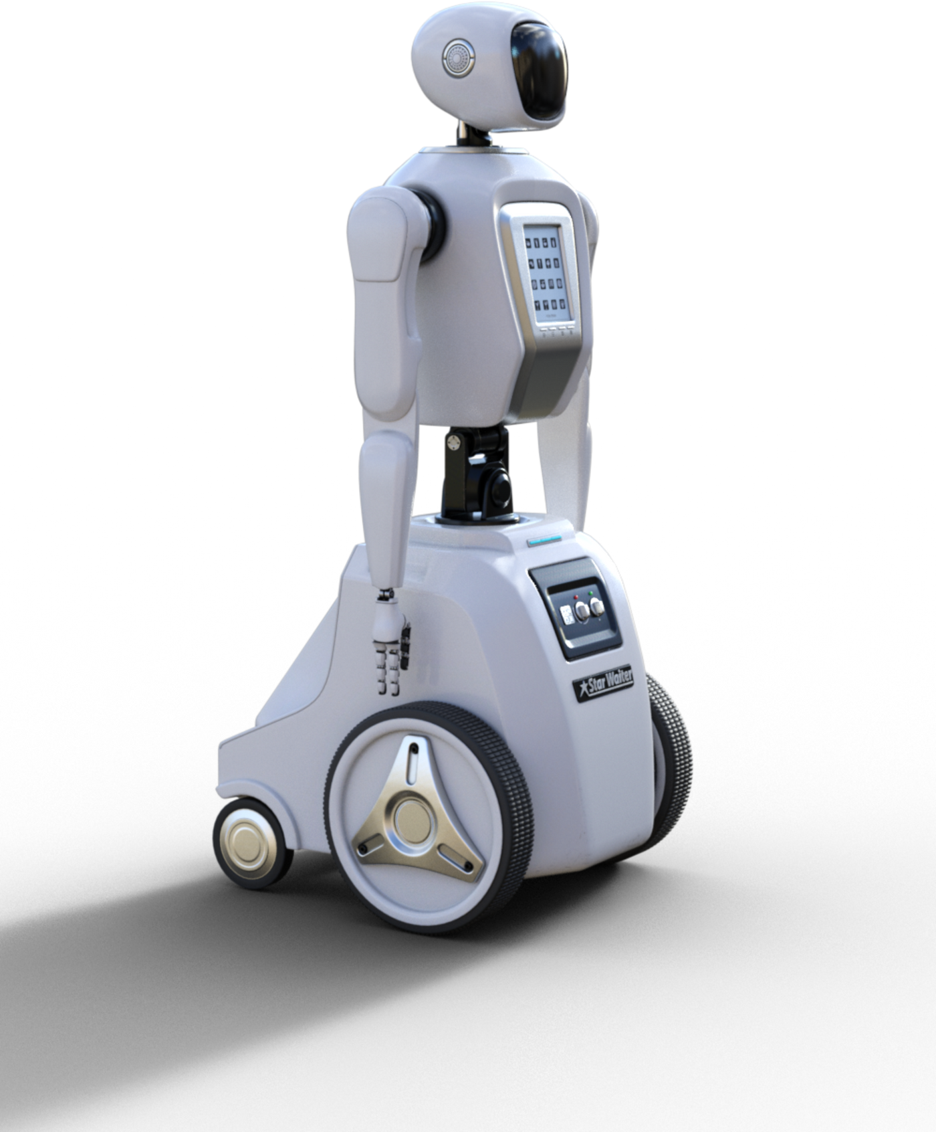
03
Problem Framing and Data Understanding
Readmissions impact patient outcomes and hospital resources
Prediction generated at discharge, not after
Strict prevention of data leakage
Success defined using both technical and clinical metrics
next
Notes:
The goal of this project is to predict whether a patient will be readmitted within 30 days of discharge.
From the start, the problem was framed around a real deployment scenario. Predictions are generated at the point of discharge, using only information available at that time.
This constraint is intentional and critical, as it prevents data leakage and ensures that the model could realistically be used in practice.

Slide 4


Data Cleaning and Feature Engineering
04
Raw healthcare data is messy and incomplete
Missing values handled using domain-aware logic
Invalid and duplicate records removed
Preprocessing pipeline built for reproducibility
next

Slide 5
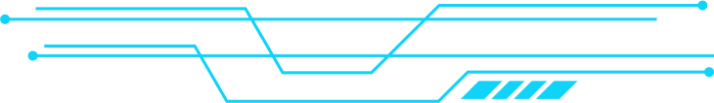

Exploratory Data Analysis & Feature Diagnostics
05
Patterns and risk signals explored through EDA
Feature distributions and correlations examined
Redundant and low-value features identified
Dimensionality reduced to improved generalization
next

Slide 6

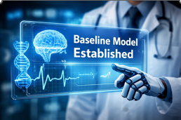



MODEL DEVELOPMENT AND EVALUATION
06
next

Slide 7


07
Explainability, Fairness and Ethical AI
Model decisions made transparent using explainability tools
Global and individual-level insights generated
Fairness assess across patient subgroups
Ethical risks explicitly discussed
next

Slide 8


Reproducibility and GitHub Structure
08
Modular, clearly numbered notebooks
Transparent repository structure
Environment reproducibility via requirement.txt
Generative AI Usage clearly documented
next

Slide 9


09
KEY MILESTONES
End-to-end ML pipeline successfully implemented
Predictions are interpretable and ethically designed
Limitations acknowledged transparently
Clear path toward validation and deployment
next

Slide 10

10
THANK YOU FOR LISTENING!
JOHN RAFFY RAYMUNDO
GITHUB LINK: Github link: Predicting 30-Day Hospital Readmissions Using Machine Learning

